Slide 1
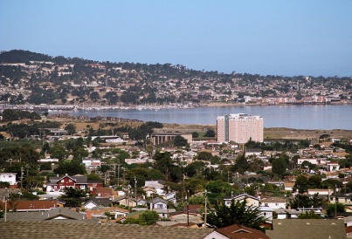
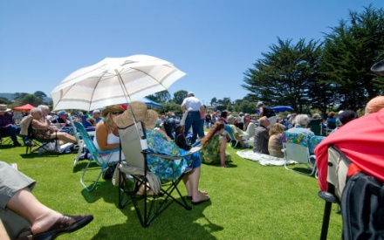
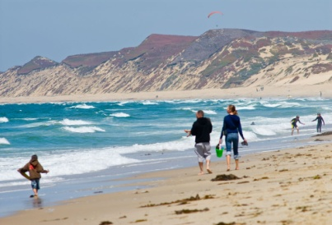
Consistency Determination:
City of Seaside Local Coastal Program
FORA Board Meeting
March 15, 2013
Agenda No: 8a

Slide 2
Local Coastal Program
Overview – Background
City is mandated by the Coastal Act to prepare a Local Coastal Program (LCP)
  Incorporates goals and policies of the Coastal Act into local regulations.
  Establishes land uses and development standards within the Coastal Zone.
    Land Use Plan (LUP) provides policies and land use designations.
    Coastal Implementation Plan (CIP) provides development standards (zoning).
2
Notes:
2

Slide 3
Local Coastal Program
Overview - Background
3
With certified LCP – City assumes permit responsibility.
  City must make finding that proposals conform to the LCP.
  Coastal Commission retains certain jurisdiction and appeal authority.
LCP, as a planning document, is subject to review every 5 years. It does not grant any project approval
Notes:
3

Slide 4
Local Coastal Program
LCP Processing Update
Seaside’s Coastal LUP was certified in 1983
Seaside’s LCP Update 2008-2013
  February 3, 2011: City Council adopted LCP, authorized submittal of LCP and implementing ordinance to Coastal Commission, and approved amendment to the Municipal Code.
  June 2, 2011: Submitted Initial LCP Application to Coastal Commission staff.
  March 19, 2012: Coastal Commission staff deemed amended LCP Application complete.
4
Notes:
4

Slide 5
Local Coastal Program
LCP Processing Update - Continued
  March through December 2012: City and Coastal Commission staff collaborated on modifications to LCP.
  December 13, 2012: Coastal Commission unanimously approved the Modified LCP.
  February 21, 2013: City Council adopted LCP, authorized submittal of LCP and implementing ordinance to Coastal Commission, and approved amendment to the Municipal Code.
  March 6, 2013: FORA Administrative Committee considered the requested Determination of Consistency and forwarded to the FORA Board with a recommendation of approval.
5
Notes:
5

Slide 6
Local Coastal Program
Primary Modifications
Collaboration with Coastal Staff
  Boundary Adjustments
    Coastal Commission staff requested modifications based on :
      Consistency with Mello Act
      Mapping advancements due to GIS
      Reflect incorporation of former Fort Ord land
  Land Use Designations
    Transportation Corridor (CTC)
  LCP Refinement
6
Notes:
6

Slide 7
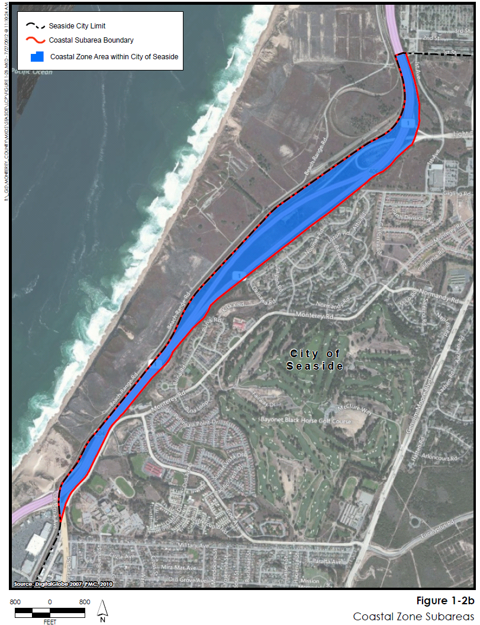
Local Coastal Program
Primary Modifications - Boundaries
Modified LCP
146 acres in former Fort Ord Lands
Caltrans Hwy 1 Public Right of Way
No projects currently proposed; LCP does not grant project approval
7
Notes:
7

Slide 8
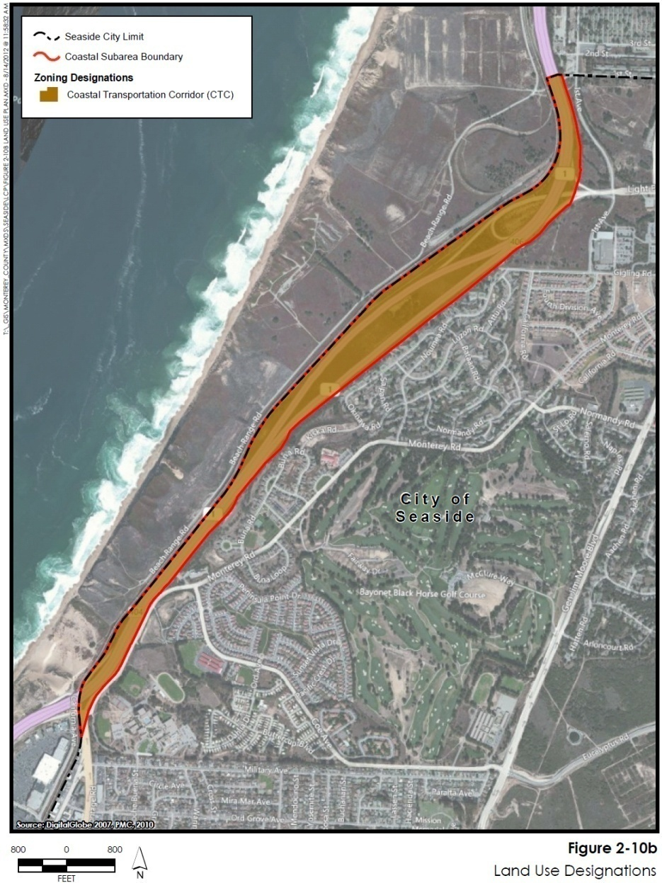
Local Coastal Program
Primary Modifications – Land Use
Modified LCP
Coastal Transportation Corridor
  Purpose: to accommodate motorized and non-motorized forms of transportation
  Allowable Uses include:
    Bike trail/pedestrian path
    Light rail
    Biking and related facilities
    Visitor/Traveler support services
8
Notes:
8

Slide 9
Local Coastal Program
Primary Modifications
LCP Refinement
Removed references to other external documents and incorporated applicable policies and development standards into the LUP and CIP.
Updated policies to strengthen consistency with Coastal Act.
Hazards Water Quality Public Access and Recreation Transportation and Circulation | Public Services Environmentally Sensitive Habitat Areas Cultural Resources Visual Resources
9
Notes:
Hazards – Addressed threats from tsunami, wave uprush/shoreline erosion and outfall maintenance provisions.
Water Quality – Addressed new RWQCB requirements associated with statewide Phase II Stormwater Permit
Land Use – Reined density/intensity and setback standards in order to adequately buffer adjacent resources to ensure they are protected.
Public Access – Increased hrs of available parking, consolidated and where feasible eliminated storm water outfall on beaches and protect lower cost visitor opportunities
Transportation – Addressed transportation capacities an former railroad r-o-w for light rail and multi-modal transportation options, encourage alternative forms of transportation, require adequate parking in new development and provide for maintenance and repair of existing transportation facilities.
Public Services – Protect coastal priority uses, ensure adequate long-term and sustainable water supplies are available for development and ensure water service are publicly managed
ESHA – provide additional detail for addressing cumulative impact and appropriate acreage replacement ratios for unavoidable direct impacts.
Cultural – rounded out archaeological protections
Visual – refine protected views particularly related to primary view corridors associate with Highway 1 and the lakes.
See Exhibit E for the track changes of the modifications
See Exhibit F for the LCP with modifications (plus the Addendum to the Coastal Staff Report)
9

Slide 10
Local Coastal Program
Recommendation/Next Steps
Request FORA Board adopt a resolution determining Seaside’s LCP is consistent with the Fort Ord BRP.
Future legislative actions by the City of Seaside regarding LCP implementation with in Fort Ord lands will come back to the FORA Board for consideration.
Provided the FORA Board determines Seaside’s LCP is consistent with the Base Reuse Plan, City staff would then forward City and FORA approving documents to the Coastal Commission to consider of the LCP certification. (April/May 2013)
10
Notes:
10

Slide 11
Questions/Comments

